Slide 1

NEXTBESTCONTENT
01 / 06
YOUR AUDIENCE IS THE BRIEF.
Your audience already wrote your next content brief
Turn audience comments into evidence-backed YouTube Shorts and LinkedIn documents.
NextBestContent
GENERATED IMAGE · FICTIONAL CREATOR
BUILT BY TRIPODS
Notes:
30 seconds
Creators rarely have an idea shortage. They have a prioritization problem: the evidence is already in their comments, but turning it into the next production decision takes work. NextBestContent treats the audience as the brief. It turns audience signals into an editable YouTube Short or LinkedIn document, while keeping the reason for every recommendation attached.
[Sources]
- README.md — product promise, current journey, and supported destinations
- src/app/_demo/fixtures.ts — final Maya fixture and explicit synthetic provenance
- [Generated asset] Fictional Maya tending a compact balcony garden; no real person or channel

Slide 2

NEXTBESTCONTENT
02 / 06
Creators have feedback everywhere—and still guess what to make next
REQUEST
“Please show the mistakes and fixes—not only the reveal.”
UNANSWERED QUESTION
“What survives a west-facing balcony if I miss one watering day?”
STRONG REACTION
“The failed first setup was more useful than the perfect reveal.”
SYNTHETIC EXAMPLE · MAYA MAKES SPACE
Useful evidence—scattered, unranked, and not yet a production plan.
FICTIONAL AUDIENCE COMMENTS · BUILT BY TRIPODS
YOUR AUDIENCE IS THE BRIEF.
Notes:
45 seconds
Picture Maya, a fictional small-space gardening creator. Her audience is already giving her useful direction, but in three different forms: a request to show the mistakes, a practical question about plant survival, and a strong reaction to the imperfect part of the story. None of those comments is a finished brief. Maya still has to identify the pattern, judge which signal matters, and decide what format should answer it. The problem is not a lack of feedback. It is that feedback arrives unranked, disconnected, and far from production-ready.
[Sources]
- README.md — three opportunity categories: request, unanswered question, and strong reaction
- src/contracts/index.ts — signal categories and evidence-backed result structure
- [Fictional content] All three comments were written for the Maya synthetic demo
- [Generated asset] Abstract message interface beside balcony-garden tools; no real social data

Slide 3
NEXTBESTCONTENT
03 / 06
NextBestContent turns comments into a decision, not another dashboard
One visible chain. Source and destination stay independent.
01
LISTEN
02
DECIDE
03
CREATE
04
PREFLIGHT
Find the audience signal
Choose with evidence
Answer in the right format
Check before export
→
→
→
Live YouTube*
Exactly 3 scored opportunities
YouTube Short
7 transparent checks
Creator import
Request · question · reaction
LinkedIn document
Evidence · clarity · CTA
Synthetic demo
Comments stay attached
Editable scene by scene
No automatic publishing
EVIDENCE IN
→
DRAFT OUT
→
LOCAL ARTIFACTS
Editable decision
YouTube or LinkedIn
Copy · storyboard · PNG · PDF
*Live YouTube remains policy-, profile-, model-, and configuration-gated.
Notes:
55 seconds
We designed the product as one visible decision chain. Listen accepts creator-owned imports, a clearly labeled synthetic demo, or policy-gated live YouTube access. Decide returns exactly three scored, source-backed opportunities, so the creator chooses instead of receiving an opaque recommendation. Create keeps source and destination independent: a LinkedIn-tagged import can become a YouTube Short, and a YouTube signal can become a LinkedIn document. Preflight checks the hook, audience fit, evidence, clarity, format, CTA, and brand safety. Provenance remains visible, the draft remains editable, and the final step produces copyable text and real local artifacts. Nothing claims to publish automatically.
[Sources]
- src/app/_components/journey.tsx — Listen → Decide → Create → Preflight
- src/contracts/index.ts — exactly three scored opportunities
- src/app/_lib/platforms.ts — independent source and destination capability registry
- src/server/preflight/evaluate.ts — seven deterministic checks
- src/app/_lib/exports.ts and src/app/_lib/pdf.ts — local Markdown, PNG, and PDF artifacts
- src/app/_components/export-screen.tsx — explicit non-publishing export experience

Slide 4
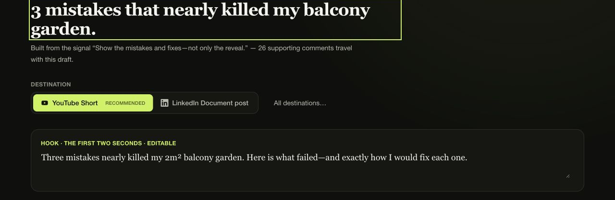
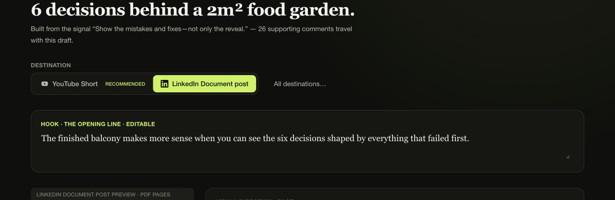


NEXTBESTCONTENT
04 / 06
Maya’s audience asks for the next story—and gets two answers
SYNTHETIC DEMO
SOURCE · “I Turned a 2m² Balcony Into a Food Garden.”
SELECTED SIGNAL · “Show the mistakes and fixes—not only the reveal.”
LIVE PRODUCT CAPTURE
LIVE PRODUCT CAPTURE
YOUTUBE SHORT · 6 SCENES
LINKEDIN DOCUMENT · 6 PAGES
3 mistakes that nearly killed my balcony garden.
6 decisions behind a 2m² food garden.
Reader-paced pages · caption · CTA · real local PDF
Timed storyboard · hook · voiceover · caption · CTA
LOCAL STORYBOARD · SAME SOURCE + SIGNAL
LOCAL PDF + PNG PAGES · DIFFERENT FORMAT
FICTIONAL CREATOR + COMMENTS · BUILT BY TRIPODS
YOUR AUDIENCE IS THE BRIEF.
Notes:
80 seconds
Now watch that chain on a complete fictional example. Maya Makes Space posts “I Turned a 2m² Balcony Into a Food Garden.” The synthetic comments do more than say viewers liked it. They reveal a specific editorial direction: “Show the mistakes and fixes—not only the reveal.” Maya selects that signal.
For YouTube, NextBestContent turns it into a six-scene Short: “3 mistakes that nearly killed my balcony garden.” The timed storyboard gives her a hook, scene copy, visual direction, voiceover, caption, and CTA.
Without repeating the analysis, Maya can change the destination to LinkedIn. The same evidence becomes a six-page, reader-paced document: “6 decisions behind a 2m² food garden.” It includes editable post text and a real locally assembled PDF export.
The important point is not simply that AI produced two formats. Both drafts answer the same audience request, and both preserve the source receipt and synthetic label all the way to export.
[Sources]
- src/app/_demo/fixtures.ts — final Maya fixture, exact case-study titles, and synthetic provenance
- src/app/_components/signals-screen.tsx — signal selection and visible provenance
- src/app/_components/short-preview.tsx — timed six-scene YouTube storyboard
- src/app/_components/carousel-view.tsx — six-page LinkedIn document preview
- src/app/_components/export-screen.tsx — destination-aware local exports
- [Generated assets] Distinct fictional balcony-garden imagery; no real creator or audience data

Slide 5
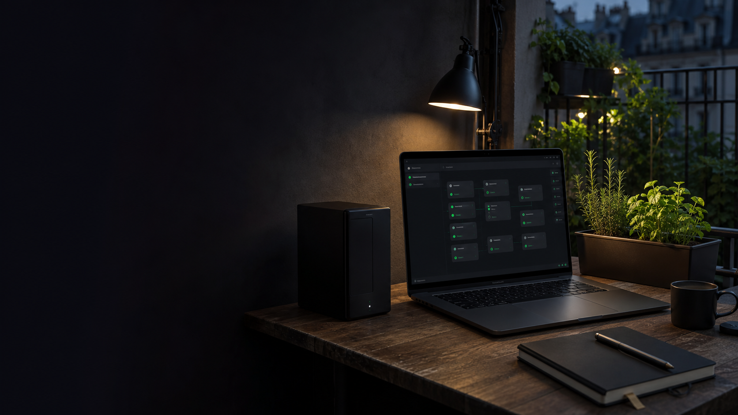
NEXTBESTCONTENT
05 / 06
Built for a public demo—and private real work
PUBLIC VERCEL
LOCAL DOCKER / SELF-HOSTED
Safe by design
Creator-controlled
Synthetic demo only
Creator-owned comment imports
No creator credentials
User-owned server-side OpenAI key
No paid model calls
YouTube behind policy + config gates
No fake publishing
Real local exports
No silent fallback
KEY BOUNDARY
298 tests passing · lint · type-check · build green
Keys remain with the creator. Model-bound content travels from their container to the configured provider.
BUILT BY TRIPODS
YOUR AUDIENCE IS THE BRIEF.
Notes:
50 seconds
The final product has two honest runtime profiles. The public-demo profile is safe by design: it runs the labeled Maya fixture, requests no credential, makes no paid model call, never pretends to publish, and never silently swaps a failed live request for demo data.
The self-hosted Docker profile is for real work. A creator imports comments they have the right to use, configures their own OpenAI key server-side, and may enable YouTube only when its technical and policy gates are satisfied. Server-managed keys never enter the browser; the optional request-scoped key path stays in memory for one run and is never persisted. Model-bound content goes from the creator’s container to the configured provider. The proof badge records the final integrated verification.
[Sources]
- README.md — runtime profiles, model-key handling, policy gates, Docker setup, and non-publishing behavior
- src/server/runtime/application-profile.ts — fail-closed public_demo and explicit self_hosted profile
- src/server/capabilities/evaluate.ts — profile-aware capability facts
- src/app/_components/export-screen.tsx — local artifacts and explicit manual publishing
- Dockerfile and compose.yaml — non-root local container and loopback-only self-hosted service
- [Verification] 298 tests passing · lint · type-check · build green
- [Generated asset] Abstract private workstation; no credentials or readable commands

Slide 6

NEXTBESTCONTENT
06 / 06
Your next content idea is already in the comments
Try Maya’s complete synthetic journey—then take the private workflow home.
TRY THE SYNTHETIC DEMO
Public URL added after anonymous access is verified
github.com/attmous/next-best-content
NOW
YouTube Shorts · LinkedIn documents
NEXT
X · Facebook · approved connections
GENERATED IMAGE · FICTIONAL GARDEN
BUILT BY TRIPODS
Notes:
30 seconds
The idea is simple enough to remember: your next content brief may already be in the comments. Once the anonymous production alias is verified, the jury can open it and run Maya’s complete synthetic journey without credentials. Creators who want to use their own comments can run the repository privately. Today, NextBestContent creates YouTube Shorts and LinkedIn documents. X, Facebook, and approved direct connections come only when they can be represented honestly. Built by Tripods.
[Sources]
- README.md — supported destinations and explicitly out-of-scope integrations
- src/app/_lib/platforms.ts — YouTube and LinkedIn availability; X and Facebook roadmap states
- [Repository] https://github.com/attmous/next-best-content
- [Pending deployment] Stable anonymous production alias before replacing the on-slide release text
- [Generated asset] Fictional balcony garden at night; no real location or creator

